Slide 1
Excel training session
API-201, Fall 2021
TF: Sophie Hill

Slide 2
Plan for today
Sophie’s 2 Golden Rules of Excellence
Getting oriented with Excel
Excel for API-201
Cleaning data
Analyzing data
Visualizing data

Slide 3
Rule #1:
Work efficiently

Slide 4
Rule #1:
Work efficiently
This is a stats class, not an Excel class.
If you are stuck on something Excel-related for more than 5 minutes… it’s time to #askforhelp!

Slide 5
Rule #2:
Work transparently

Slide 8
Rule #2:
Work transparently
Make your Excel sheet intelligible to your future self / your collaborators / your hypothetical boss!
Break calculations down into smaller steps
Use sensible column/sheet names

Slide 9
But first… The Basics
Disclaimer: I am using Microsoft Excel for Mac version 16 (Office 365). Things may look slightly different depending on your version and operating system.

Slide 10
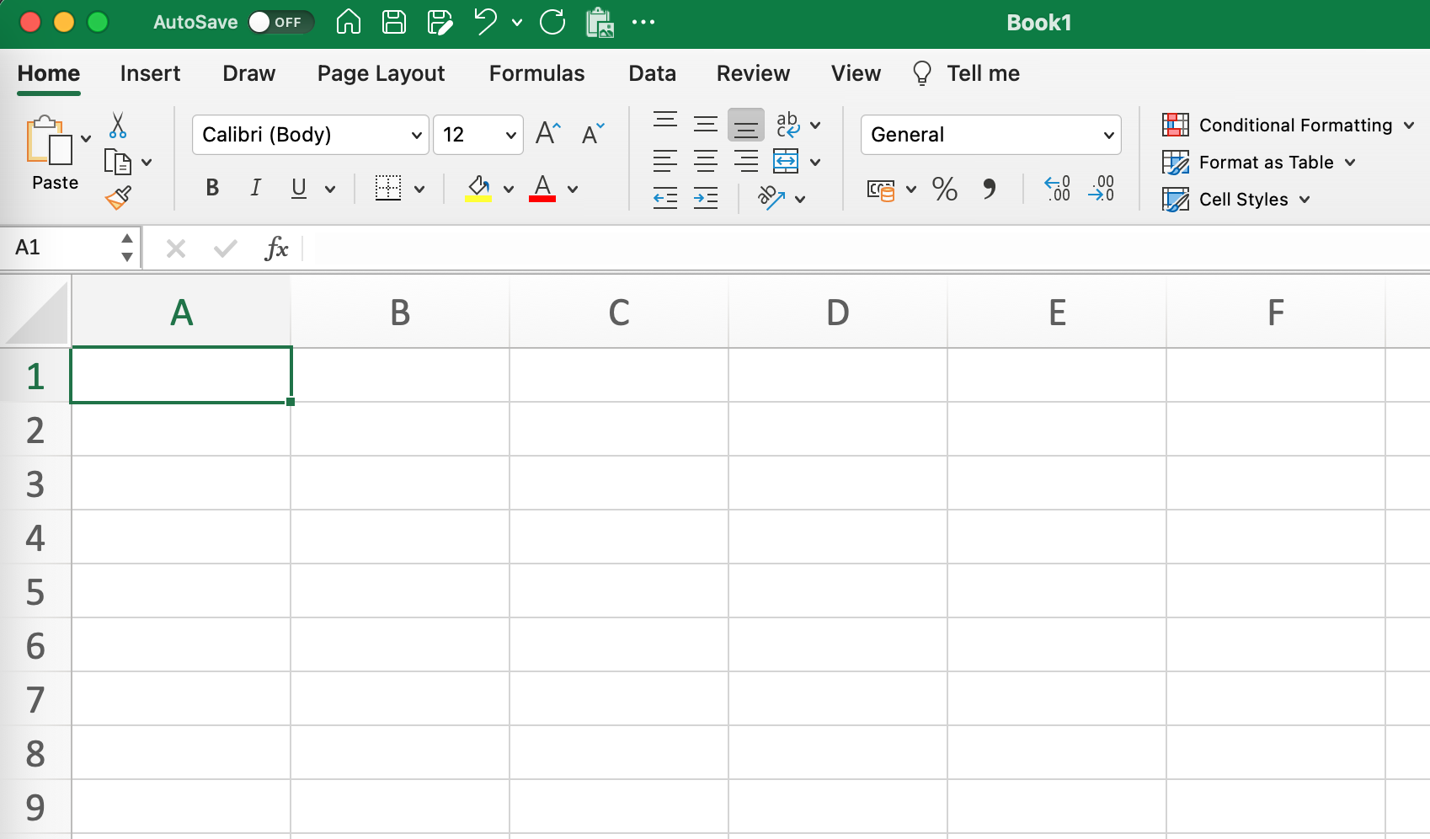
Getting oriented
Menu bar

Slide 11
Getting oriented
Highlighted cell

Slide 12
Getting oriented
Formula bar

Slide 13
Getting oriented
Sheet

Slide 14
Getting oriented
Rows
(numbers)

Slide 15
Getting oriented
Columns
(letters)

Slide 16
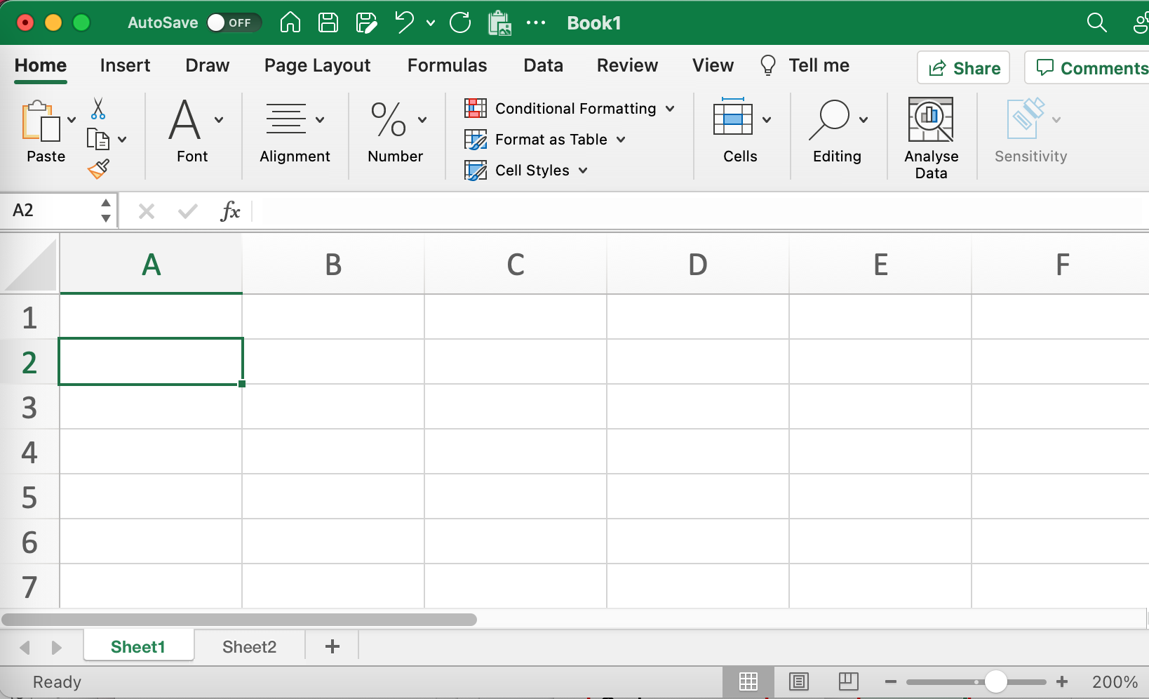
Getting oriented
Tabs

Slide 17
Syntax: referencing cells
A1 | The cell A1
A1:A3 | The cells A1, A2, A3
A:A
A:B
A1:B7
$A$1
Sheet1!A1

Slide 18
Syntax: referencing cells
A1 | The cell A1
A1:A3 | The cells A1, A2, A3
A:A | The whole A column
A:B
A1:B7
$A$1
Sheet1!A1

Slide 19
Syntax: referencing cells
A1 | The cell A1
A1:A3 | The cells A1, A2, A3
A:A | The whole A column
A:B | The whole of columns A and B
A1:B7
$A$1
Sheet1!A1

Slide 20
Syntax: referencing cells
A1 | The cell A1
A1:A3 | The cells A1, A2, A3
A:A | The whole A column
A:B | The whole of columns A and B
A1:B7 | The array covering A1 down to A7 and B1 down to B7
$A$1
Sheet1!A1

Slide 21
Syntax: referencing cells
A1 | The cell A1
A1:A3 | The cells A1, A2, A3
A:A | The whole A column
A:B | The whole of columns A and B
A1:B7 | The array covering A1 down to A7 and B1 down to B7
$A$1 | A fixed reference to cell A1 that won’t change when you copy a formula to another cell
Sheet1!A1

Slide 22
Syntax: referencing cells
A1 | The cell A1
A1:A3 | The cells A1, A2, A3
A:A | The whole A column
A:B | The whole of columns A and B
A1:B7 | The array covering A1 down to A7 and B1 down to B7
$A$1 | A fixed reference to cell A1 that won’t change when you copy a formula to another cell
Sheet1!A1 | Cell A1 on Sheet 1

Slide 23
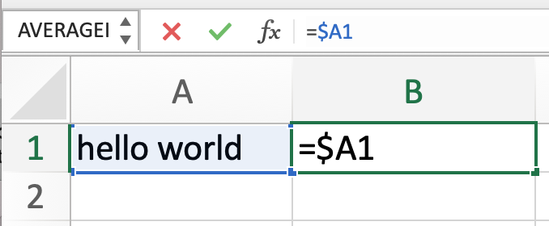
Syntax: understanding check!
Cell A1 contains a text string (“hello world”).
Cell B1 contains a formula (“=$A1”).

Slide 24
Syntax: understanding check!
Cell A1 contains a text string (“hello world”).
Cell B1 contains a formula (“=$A1”).
What will B1 evaluate to?

Slide 25
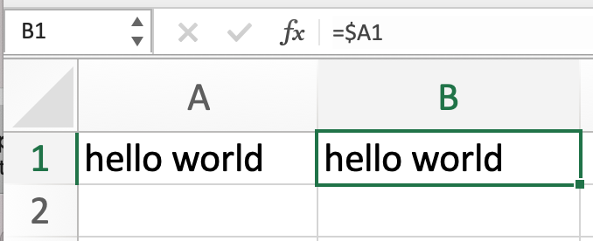
Syntax: understanding check!
Cell A1 contains a text string (“hello world”).
Cell B1 contains a formula (“=$A1”).
What will B1 evaluate to?

Slide 26
Syntax: understanding check!
Cell A1 contains a text string (“hello world”).
Cell B1 contains a formula (“=$A1”).
What will B1 evaluate to?
What will happen if I copy the contents of cell B1 into cell B2?

Slide 27
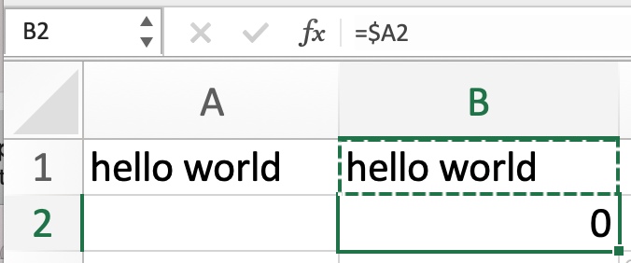
Syntax: understanding check!
Cell A1 contains a text string (“hello world”).
Cell B1 contains a formula (“=$A1”).
What will B1 evaluate to?
What will happen if I copy the contents of cell B1 into cell B2?

Slide 28
Syntax: understanding check!
Why?
Because “$A1” only fixes the column, not the row!
So cell B2 now contains the formula “=$A2” and cell A2 is empty.
Cell A1 contains a text string (“hello world”).
Cell B1 contains a formula (“=$A1”).
What will B1 evaluate to?
What will happen if I copy the contents of cell B1 into cell B2?

Slide 29
Syntax: fixed references
A1 | Neither row nor column is fixed
$A1 | Column is fixed
A$1 | Row is fixed
$A$1 | Row and column are fixed

Slide 30
Syntax: formulas
In Excel, formulas must start with the equals sign (=)
Otherwise, Excel doesn’t know if you want to calculate the SUM or just write the word “sum”!

Slide 31
Syntax: formulas
In Excel, formulas must start with the equals sign (=)
Otherwise, Excel doesn’t know if you want to calculate the SUM or just write the word “sum”!
Functions take arguments separated by commas:
=MYFUNCTION(argument1, argument2, argument3)

Slide 32
Syntax: formulas
An argument could be:
a number
a text string in quotes
a cell or range of cells
a logical condition
the output of another function

Slide 33
Syntax: formulas
An argument could be:
a number
a text string in quotes
a cell or range of cells
a logical condition
the output of another function
=IF(A1>0, “this is a positive number”, 0)

Slide 34
Syntax: formulas
An argument could be:
a number
a text string in quotes
a cell or range of cells
a logical condition
the output of another function
=IF(A1>0, “this is a positive number”, 0)

Slide 35
Syntax: formulas
An argument could be:
a number
a text string in quotes
a cell or range of cells
a logical condition
the output of another function
=IF(A1>0, “this is a positive number”, 0)

Slide 36
Syntax: formulas
An argument could be:
a number
a text string in quotes
a cell or range of cells
a logical condition
the output of another function
=IF(A1>0, “this is a positive number”, 0)

Slide 37
Syntax: formulas
An argument could be:
a number
a text string in quotes
a cell or range of cells
a logical condition
the output of another function
=IF(A1>0, “this is a positive number”, AVERAGE(A:A))

Slide 38
Syntax: formulas
An argument could be:
a number
a text string in quotes
a cell or range of cells
a logical condition
the output of another function
=IF(A1>0, “this is a positive number”, AVERAGE(A:A))

Slide 39
“Give an MPP a COUNTIF, and they will complete the problem set today.
Teach an MPP how to use the Excel help function, and they will complete the problem sets forever.”
–– API-201 proverb

Slide 40
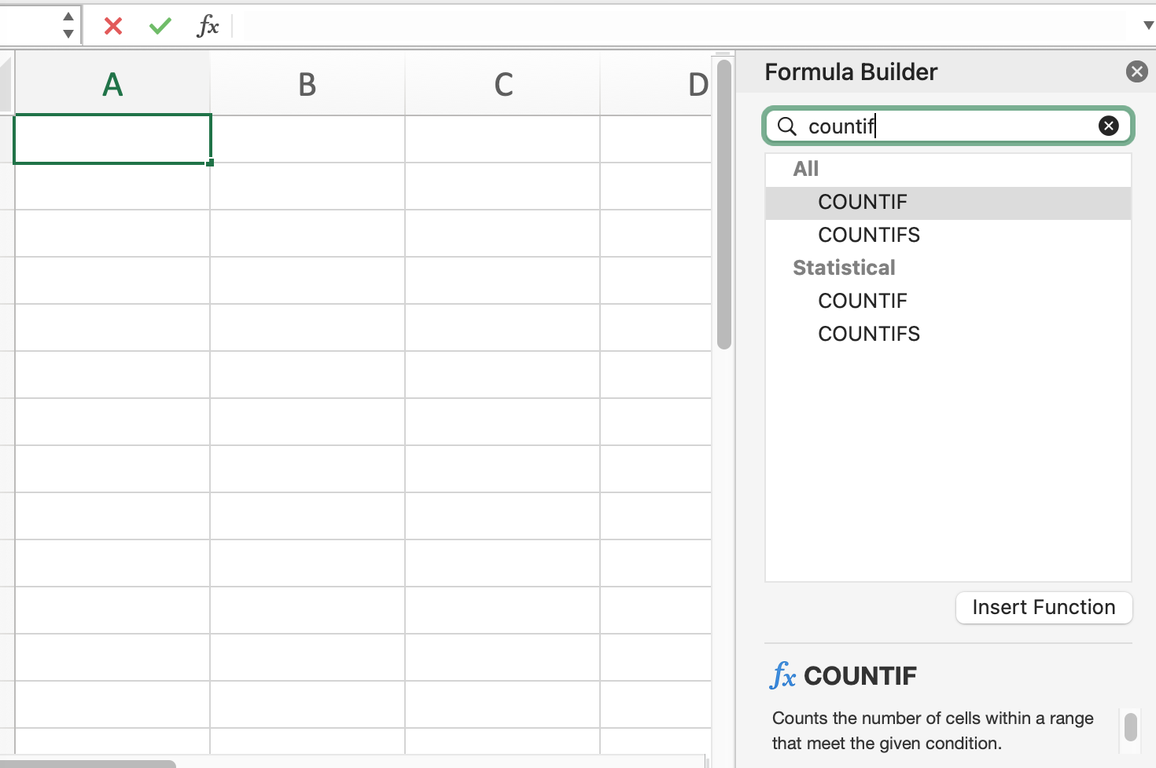
Formula builder
To bring up the Formula Builder, click on the function button (fx).
You can search for a function by name.

Slide 41
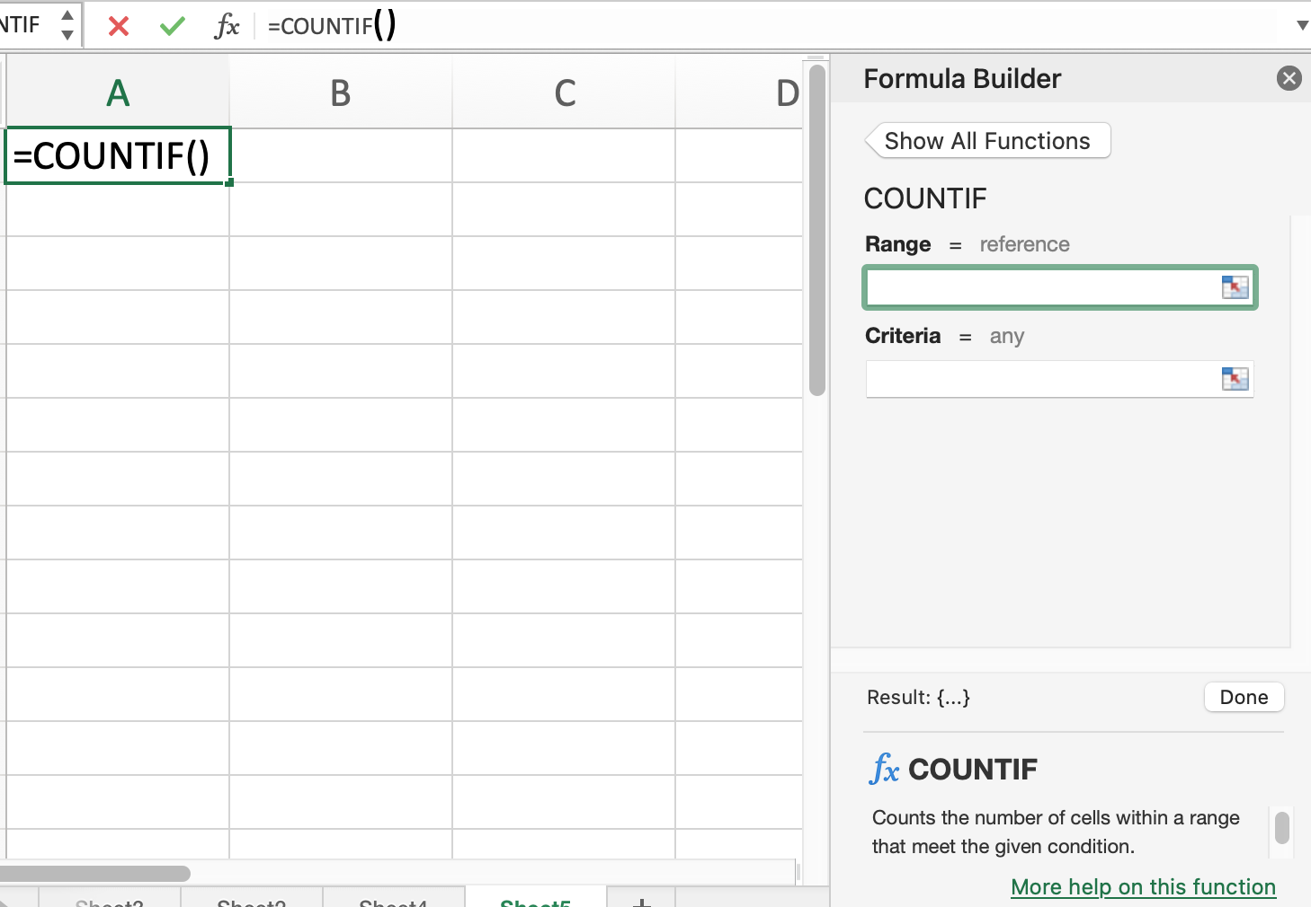
Formula builder
Click on the function you want, and it will show you the arguments you need to enter.
Click on “More help on this function” to see examples.

Slide 42
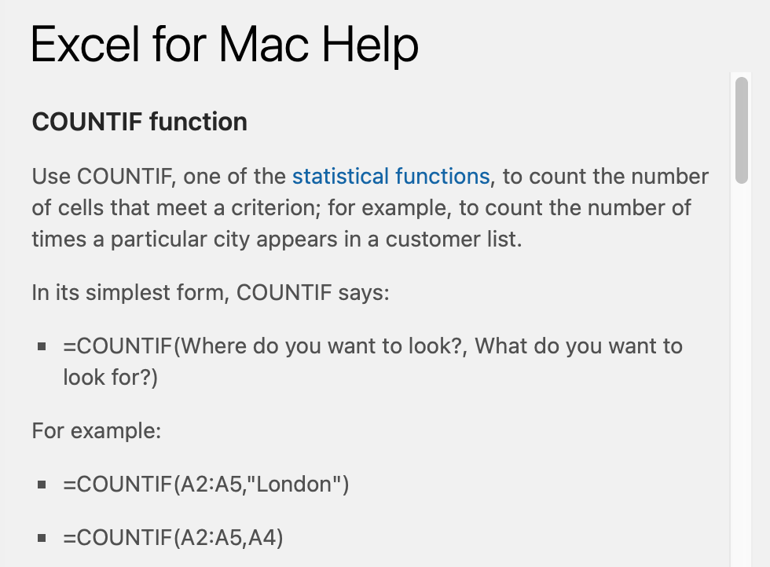
Formula builder
Click on the function you want, and it will show you the arguments you need to enter.
Click on “More help on this function” to see examples.

Slide 43
Cleaning data
i.e., getting the data into a format that is most useful to us

Slide 44
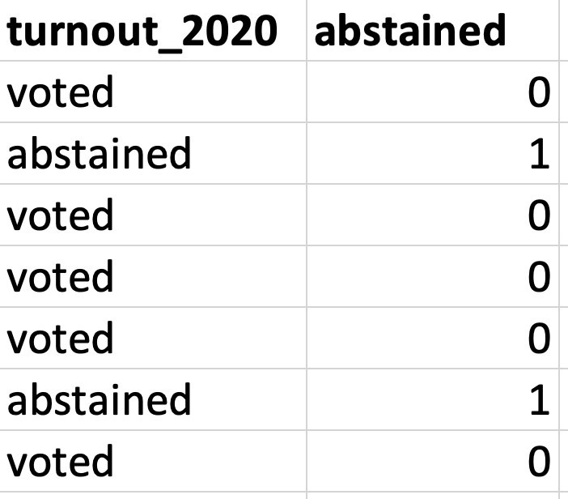
Recoding variables
There are many ways to encode information.
Sometimes we might want to switch, e.g., from categorical variable to a numeric variable.

Slide 45
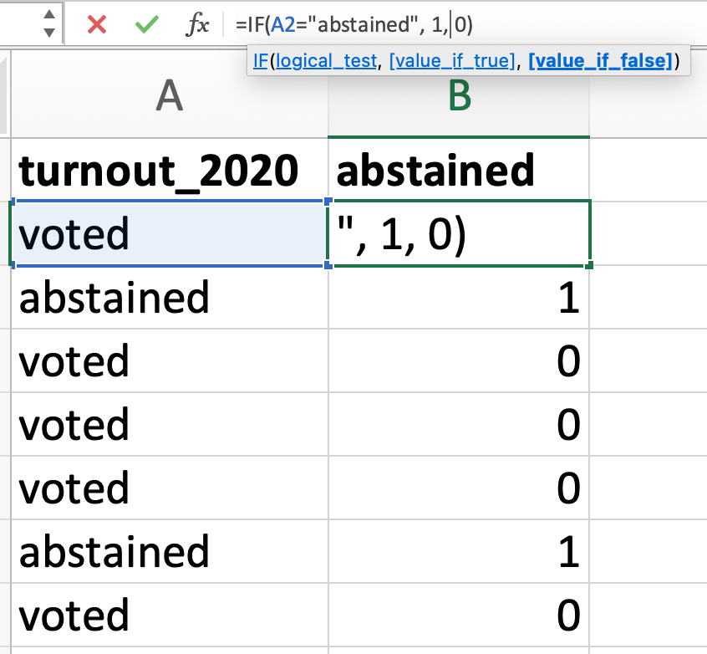
Recoding variables
We can use the IF function to recode variables.
Note that Excel helpfully gives us the syntax of the function as a pop-up.

Slide 46
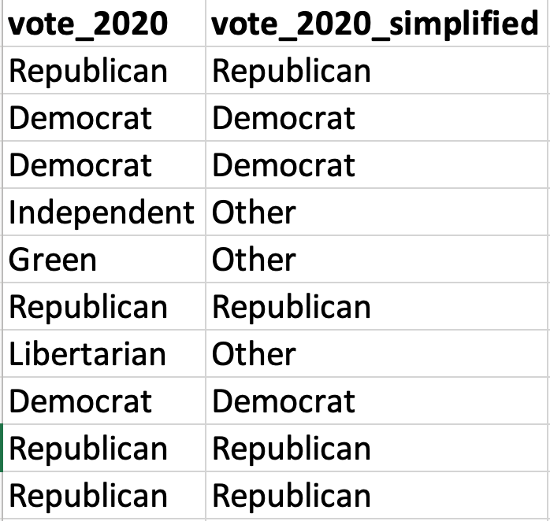
Recoding variables
There are many ways to encode information.
Sometimes we might want to collapse a variable down into fewer categories.

Slide 47
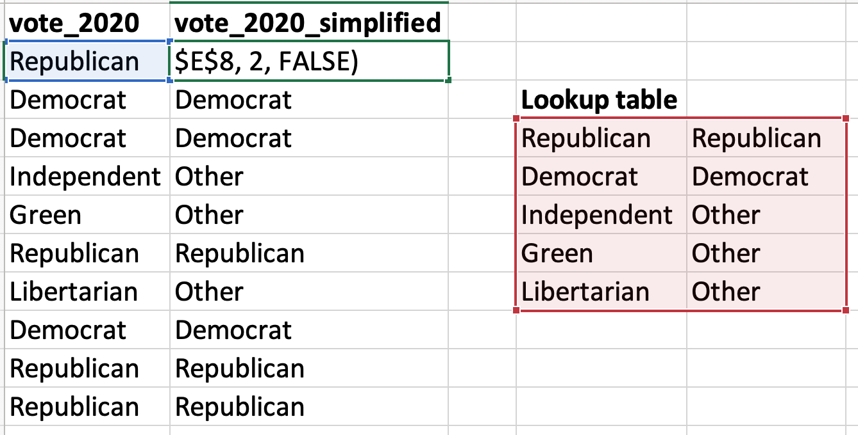
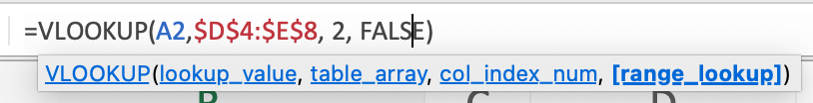
Recoding variables
But what if we have more than two categories?
We could nest multiple IF functions, but that gets messy!
Instead, we can use the VLOOKUP function with a lookup table.

Slide 48
Analyzing data
i.e., calculating descriptive statistics, performing statistical tests

Slide 49
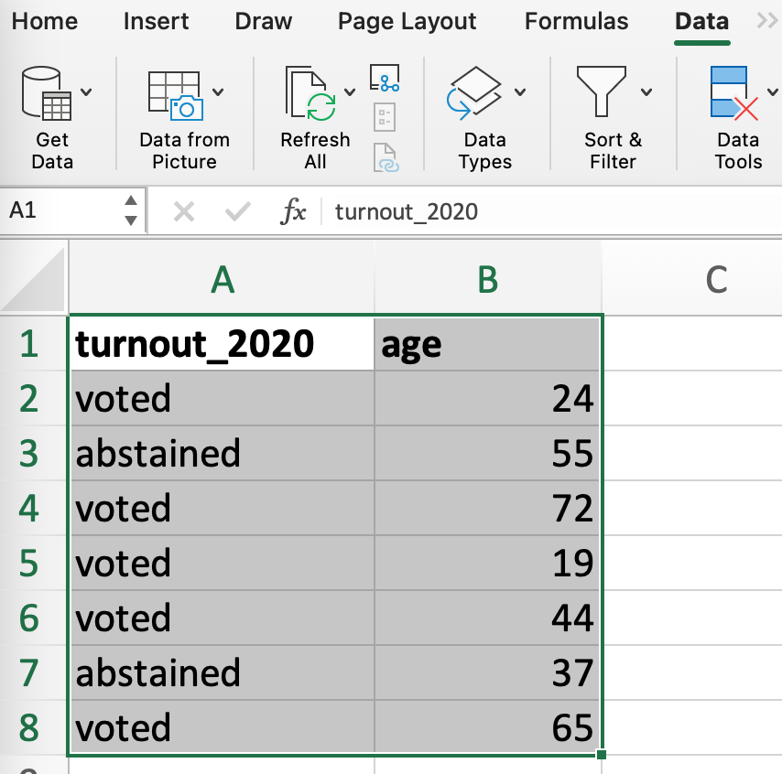
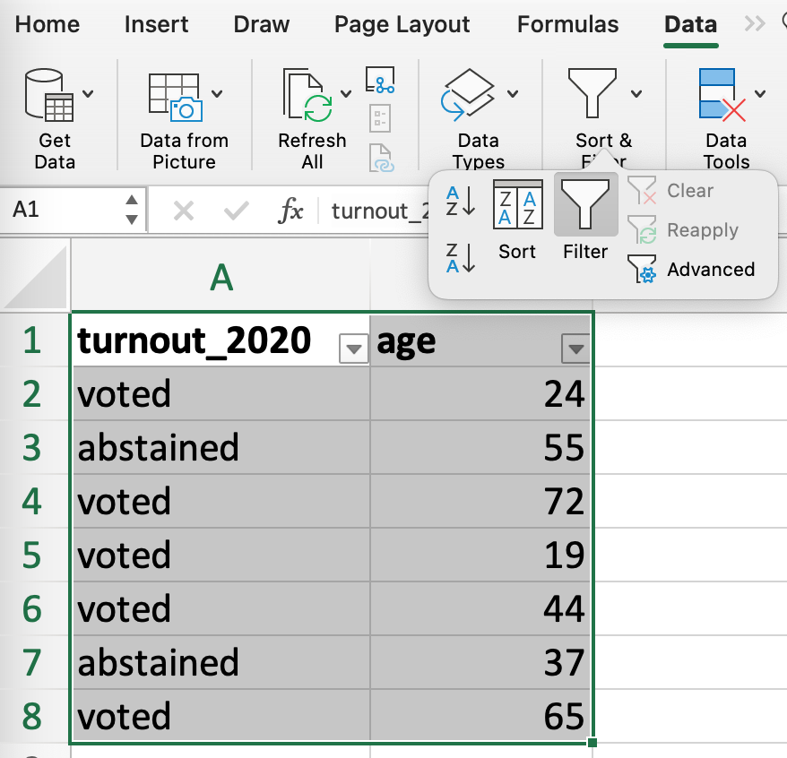
Tables
Turning our data into a table allows us to sort and filter by different variables

Slide 50
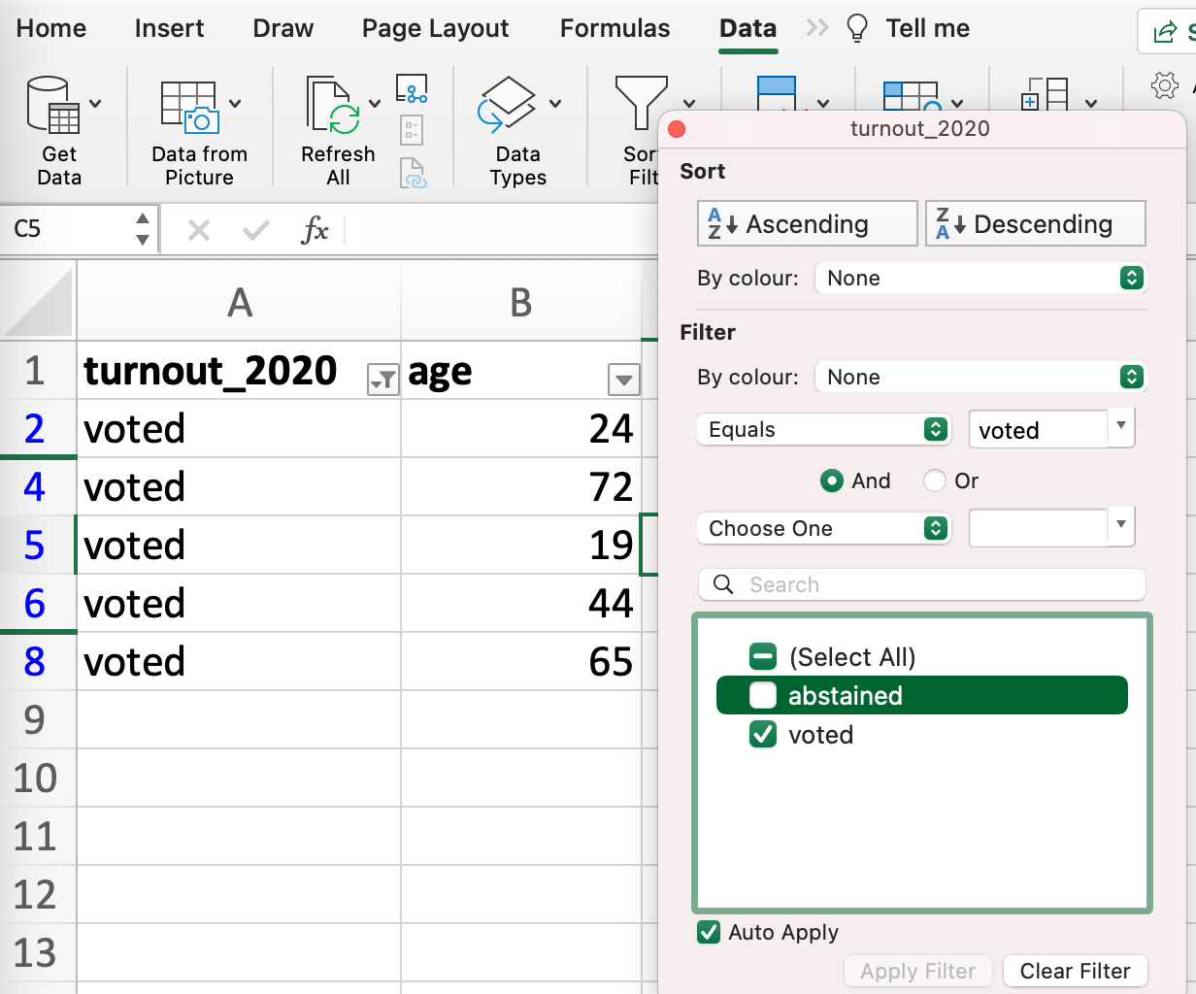
Tables
Tables are a great way to explore a dataset.
However, if you have a BIG dataset with LOTS of variables, using a table can be slow and confusing.
In these cases, we probably want to use functions instead.

Slide 51
Descriptive statistics
Function | What does it do?
COUNT | Counts the number of cells that contain a number
SUM | Adds up the cells
AVERAGE | Takes the mean of the cells
STDEV.P / STDEV.S | Standard deviation for a population / a sample
MEDIAN | Takes the median of the cells

Slide 52
Descriptive statistics
Function | What does it do?
COUNT / COUNTIF / COUNTIFS | Counts the number of cells that contain a number (or meet a certain condition)
SUM / SUMIF / SUMIFS | Adds up the cells (or the cells that meet a certain condition)
AVERAGE / AVERAGEIF / AVERAGEIFS | Takes the mean of the cells (or the cells that meet a certain condition)
STDEV.P / STDEV.S | Standard deviation for a population / a sample
MEDIAN | Takes the median of the cells

Slide 53
Statistical tests (don’t need to worry about these yet!)
Function | What does it do?
NORM.S.INV | Inverse of the standard normal distribution, used for finding critical values
NORM.S.DIST | Standard normal distribution, used for finding p-values
CHISQ.TEST | Chi-squared test

Slide 54
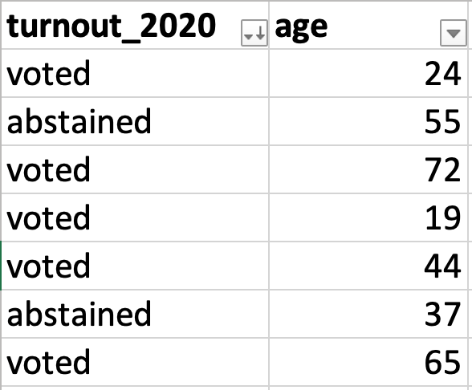
Understanding check: let’s figure out how to use AVERAGEIF!
Suppose we want to calculate the average age of the individuals in our data who voted in 2020.
We can use AVERAGEIF! But how does the syntax work?
Let’s use the Formula Builder...

Slide 55
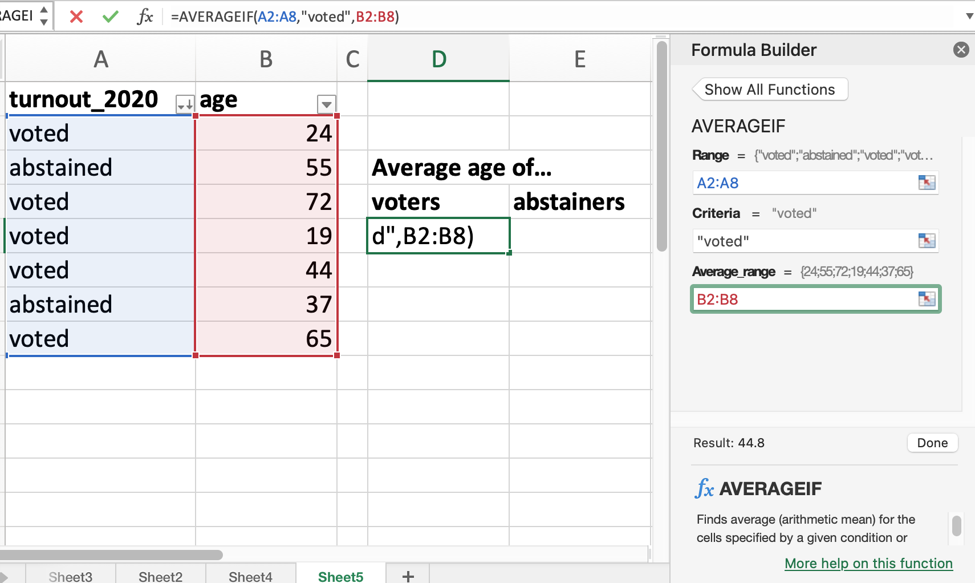
Understanding check: let’s figure out how to use AVERAGEIF!

Slide 56
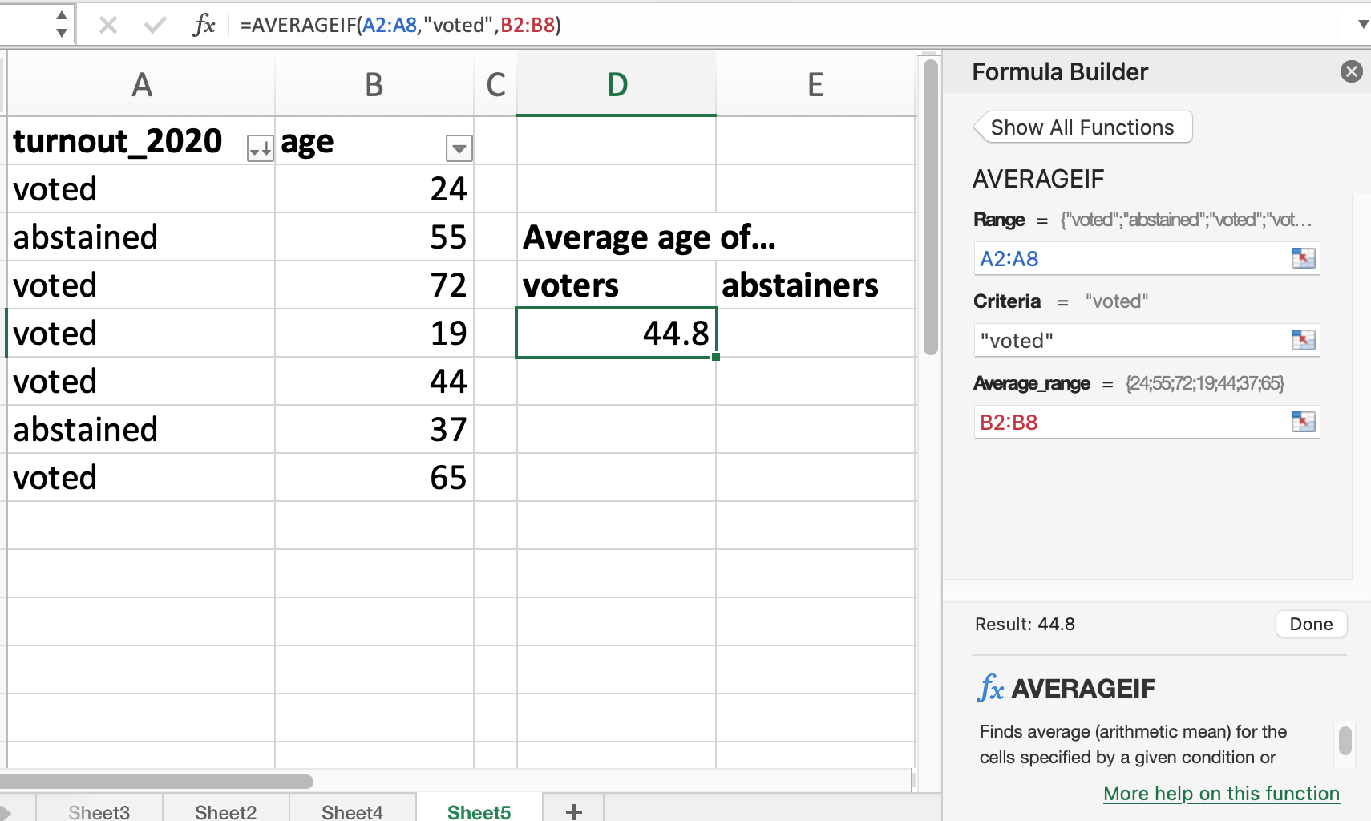
Understanding check: let’s figure out how to use AVERAGEIF!

Slide 57
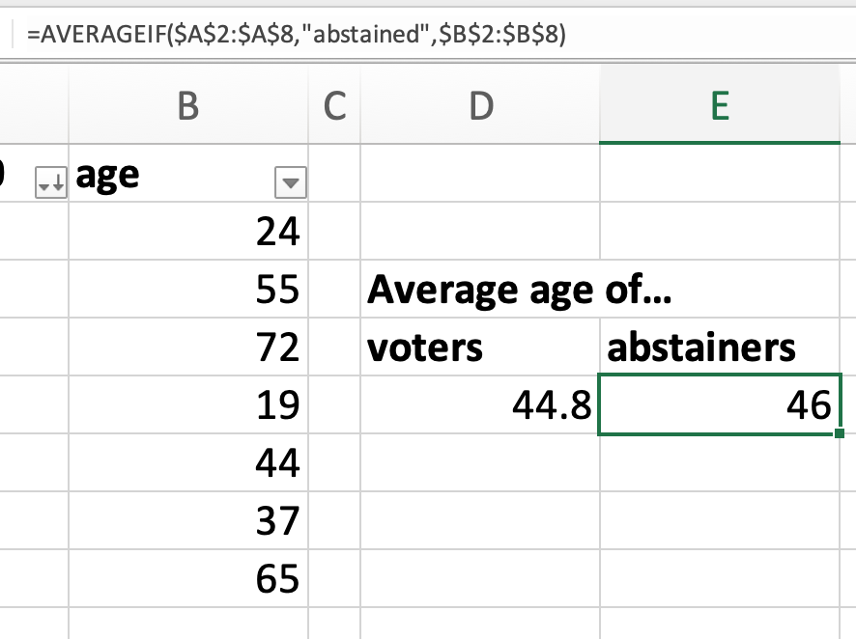
Understanding check: let’s figure out how to use AVERAGEIF!
To do the same calculation for the abstainers, I made 2 changes:
I added $ to the cell references to keep it fixed when I copied it!
I changed “voted” to “abstained”
Easy!

Slide 58
Visualizing data
i.e., making graphs!

Slide 59
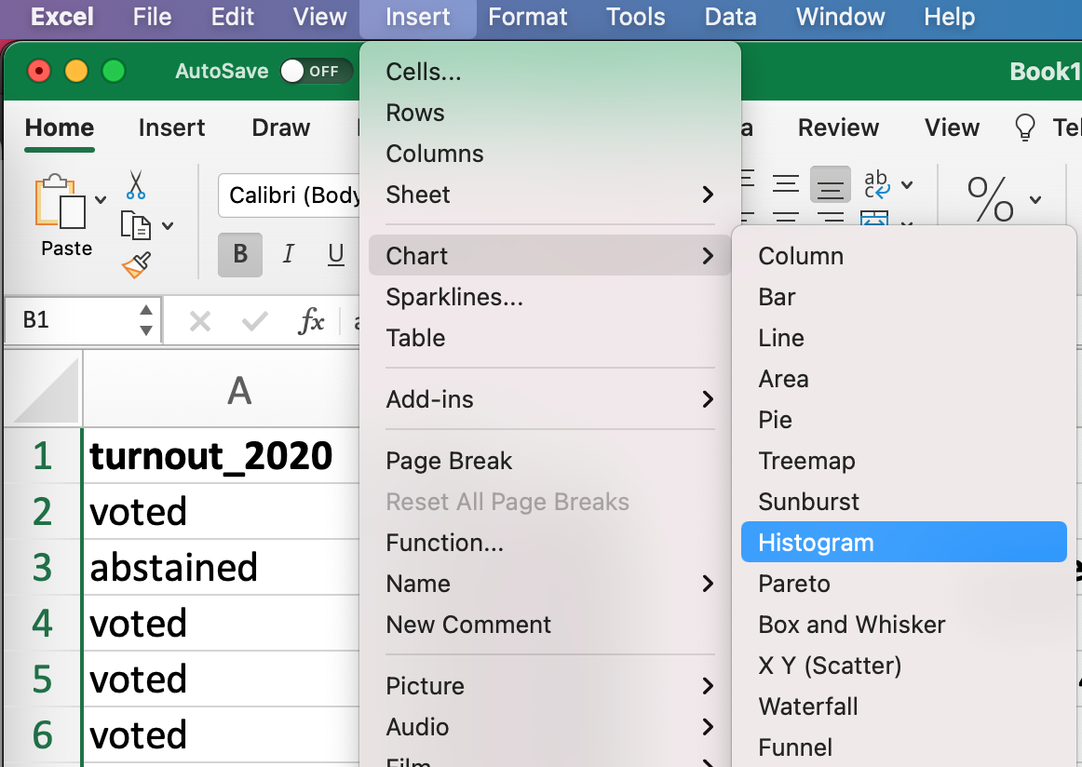
Charts: one variable
Highlight the column we want to display
Go Insert → Chart → Histogram

Slide 60
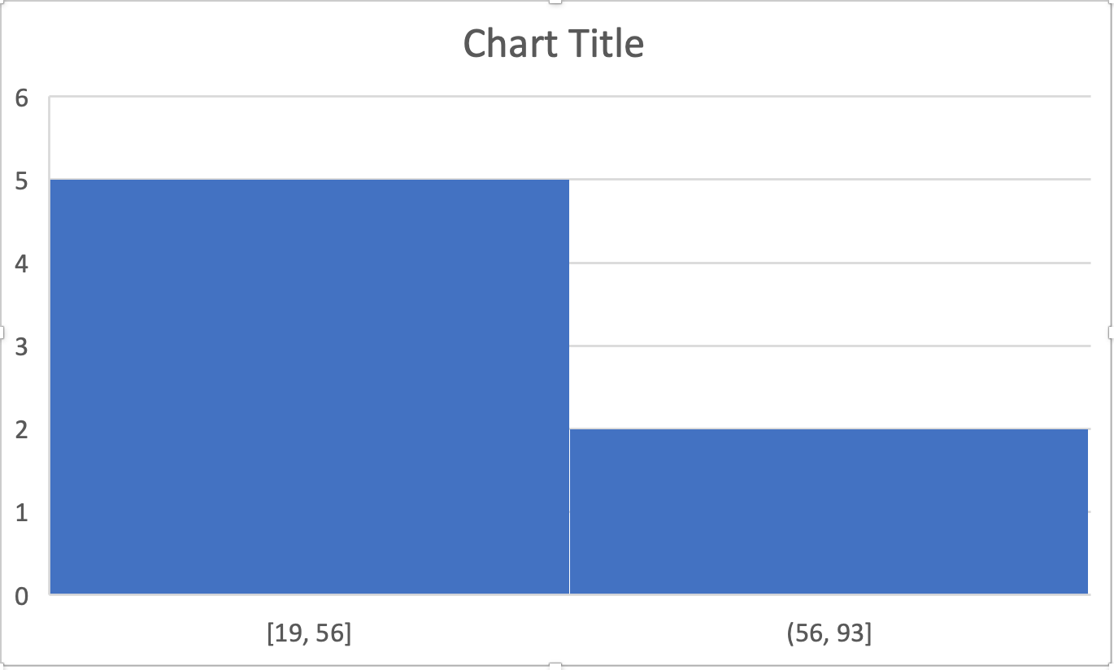
Charts: one variable
Excel will spit out some default chart.
It will not be pretty!
But that’s ok.

Slide 61
Charts: one variable
Protip: to change something on a chart, double-click on that element!
Excel will spit out some default chart.
It will not be pretty!
But that’s ok.

Slide 62
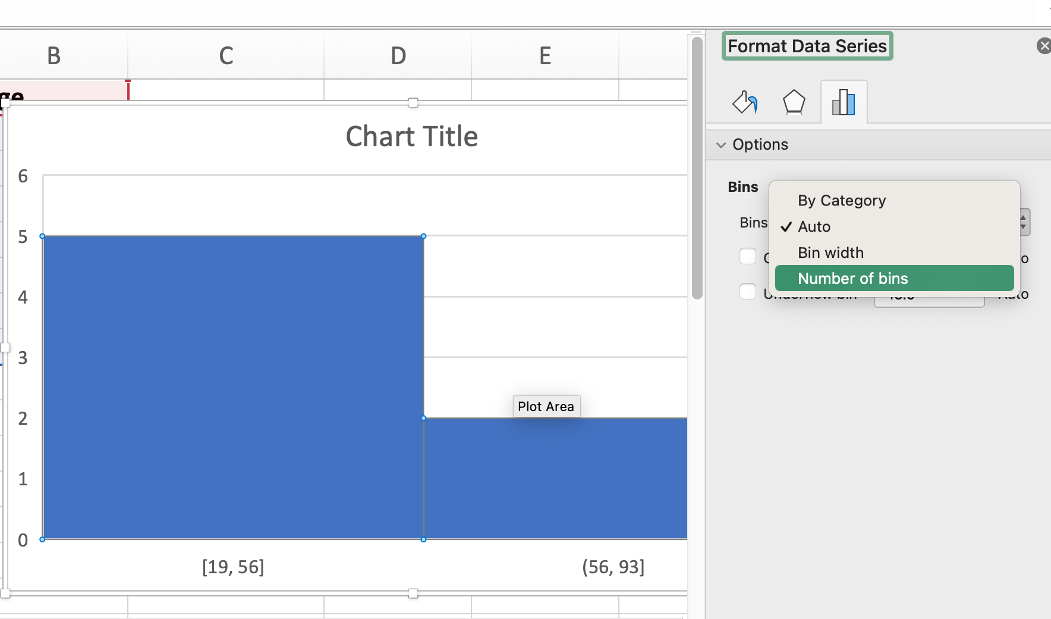
Charts: one variable

Slide 63
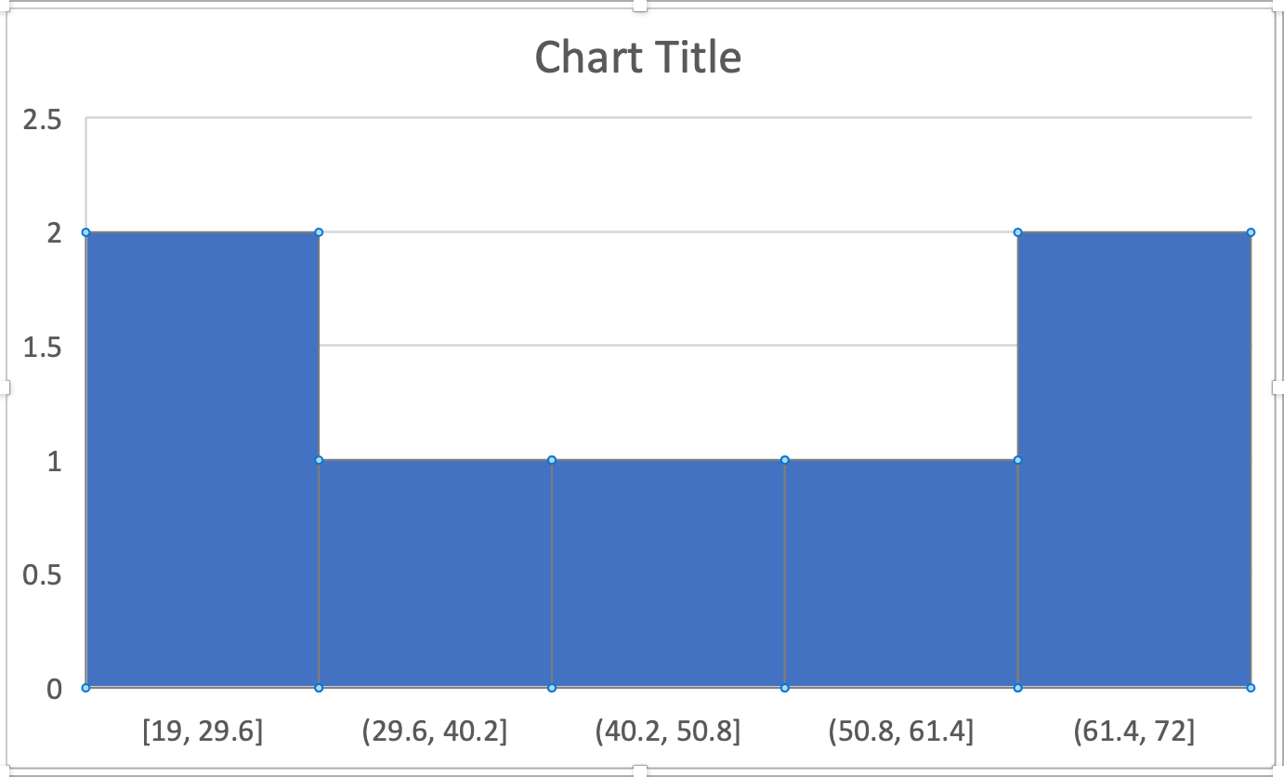
Charts: one variable

Slide 64
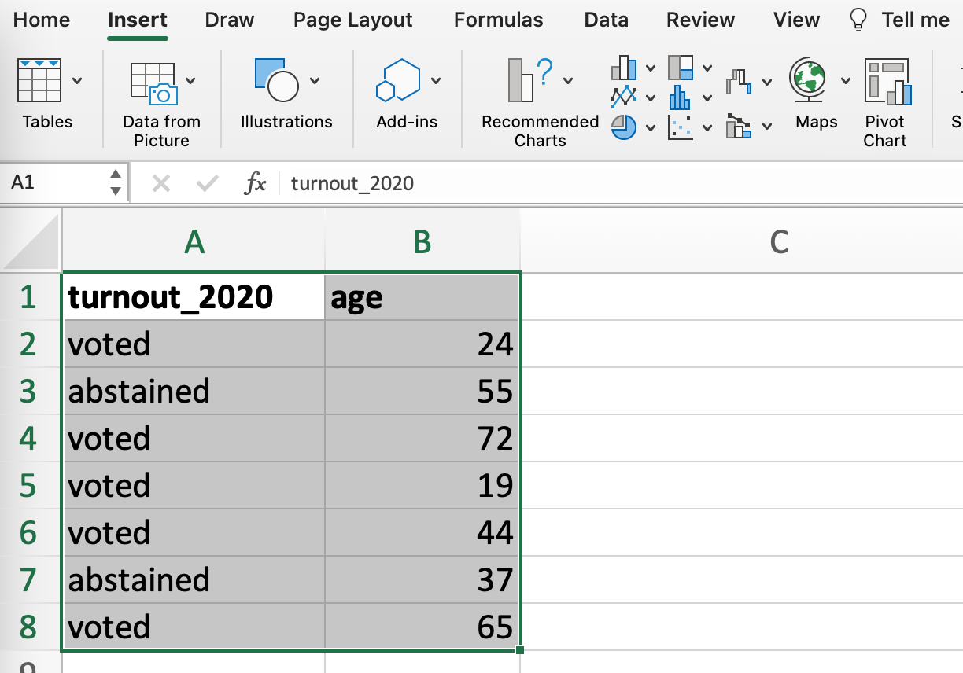
Charts: multiple variables

Slide 65
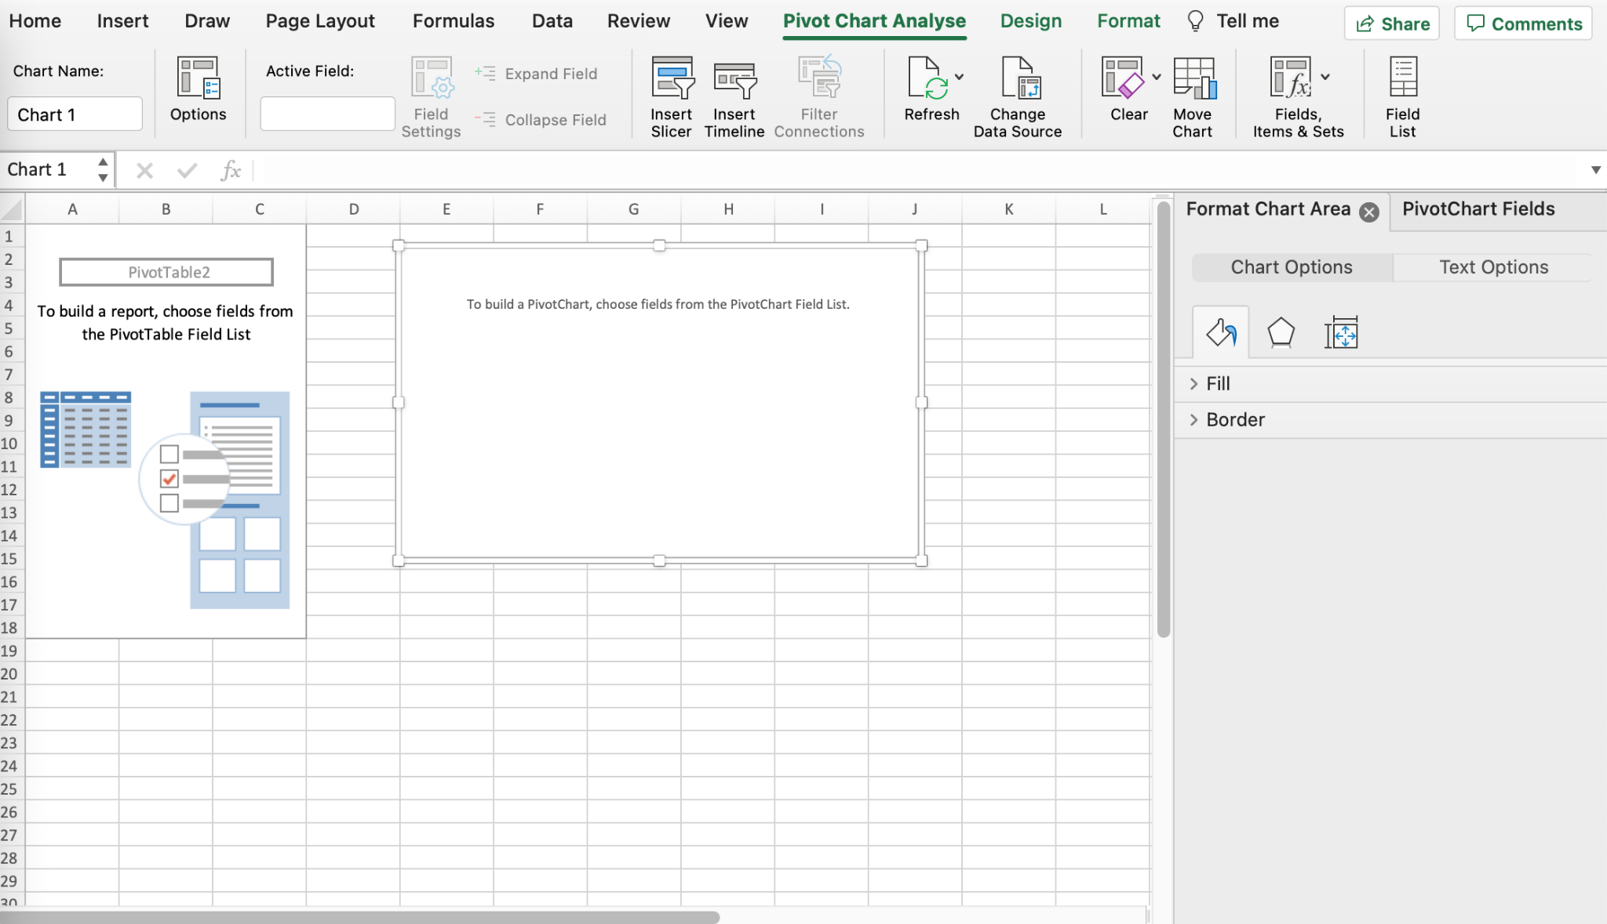
Charts: multiple variables

Slide 66
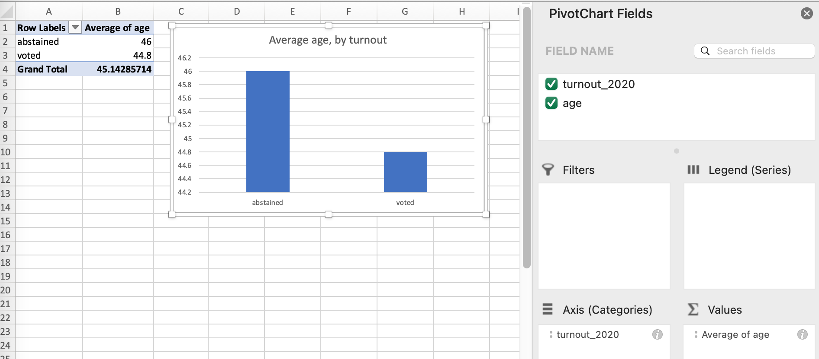
Charts: multiple variables

